Slide 1
The Virtual Judge Experiment
An Incarceration Analysis of Texas
By Kyle, Irvin, Marisol

Slide 2
Can we predict an individual's sentencing based on all factors?
What factors give the most weight to the decision? Can we be more fair than a real judge?
Can we predict if an inmate is going to be approved for parole?

Slide 3
Overview
Getting to know the data
Feature Engineering
Categorical Boost (Cat Boost Classifier)
The Real World Application: Uncovering human biases in our criminal justice system

Slide 4
Description Of Data

Slide 5
Texas Incarceration
Texas Department of Criminal Justice
A collection from all prison facilities in Texas
Rows
117697
Columns
19

Slide 6
Columns
Gender
Race
Age
Projected Release
Maximum Sentence Date
Parole Eligibility Date
County
TDCJ Offense
Sentence Date
Offense Date
Sentence (Years)
Last Parole Decision
Next Parole Review Date
Parole Review Status
Current Facility

Slide 7
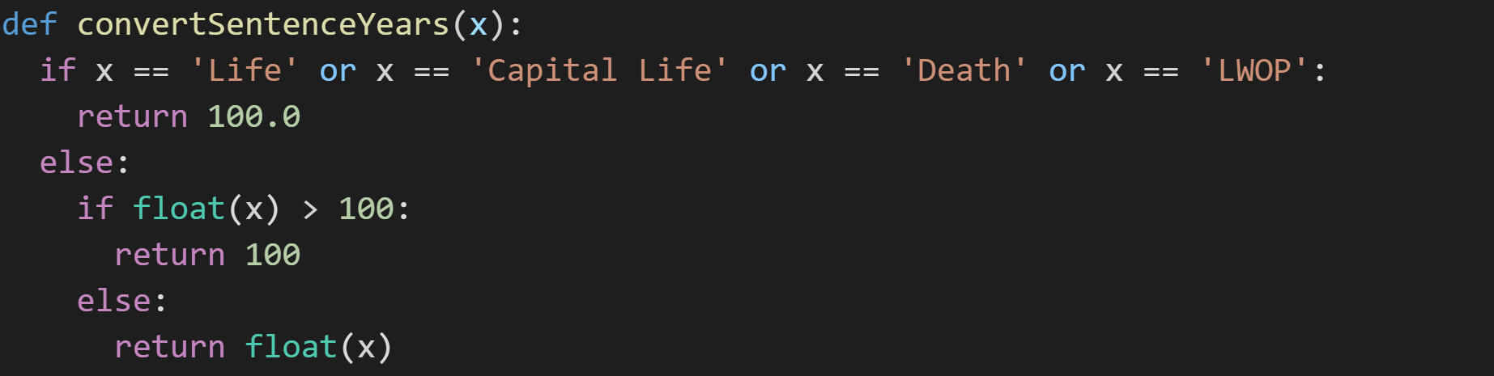
Scaling for Life

Slide 8
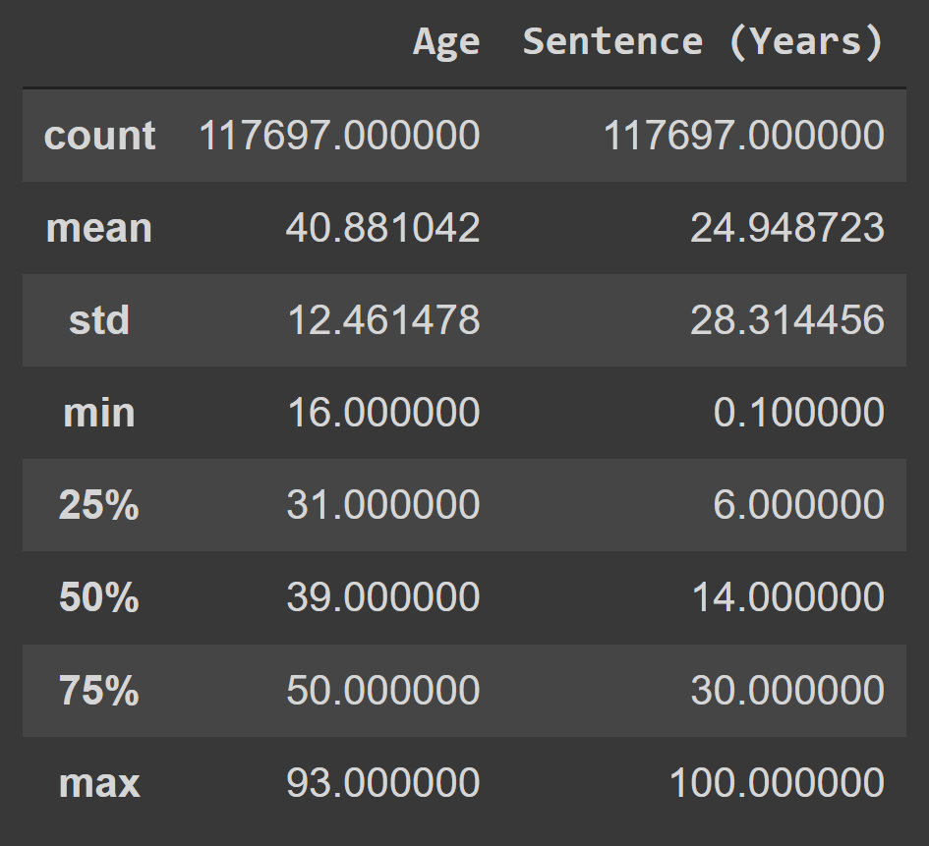
Sentence Years Analysis

Slide 9
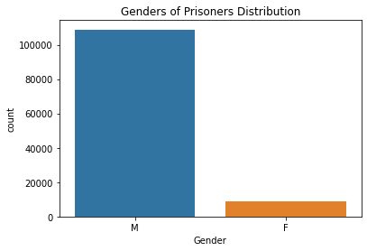
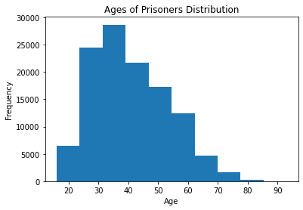

Slide 10
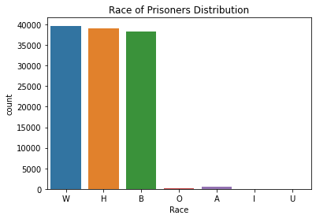

Slide 11

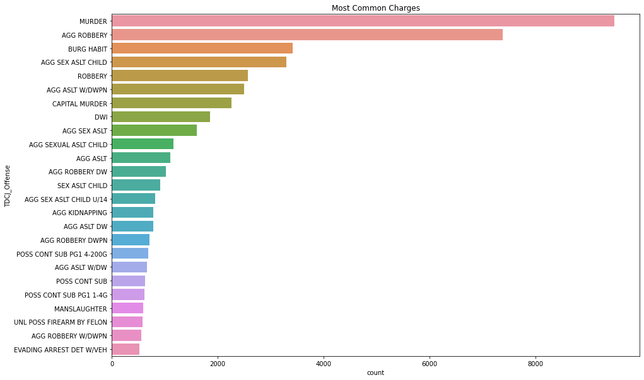

Slide 12
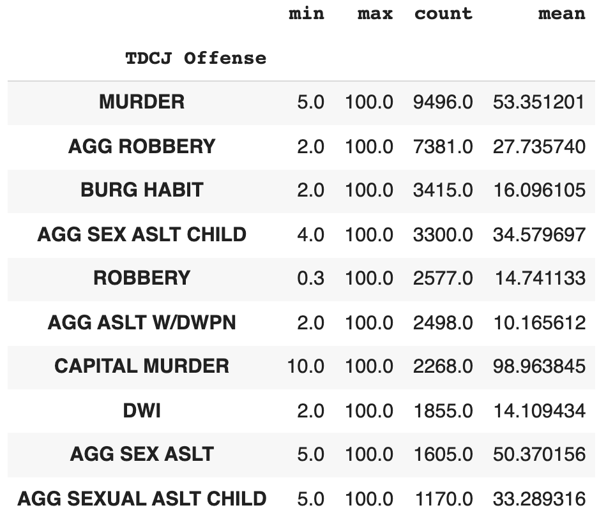

Slide 13
2. Feature Engineering

Slide 14
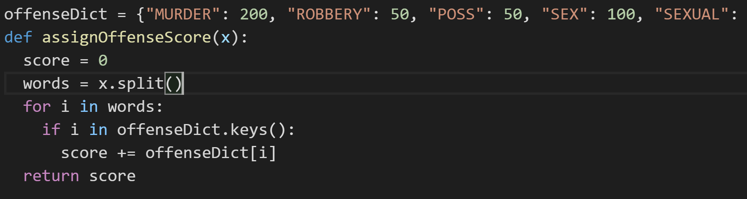
New Column: “Offense Score”
"MURDER": 200
"ROBBERY": 50
"POSS": 50
"SEX": 100
"SEXUAL": 100
"AGG": 100
"ASSAULT": 100
"ALST": 100
"CHILD": 100
"<1G": 50
"DWI": 50

Slide 15
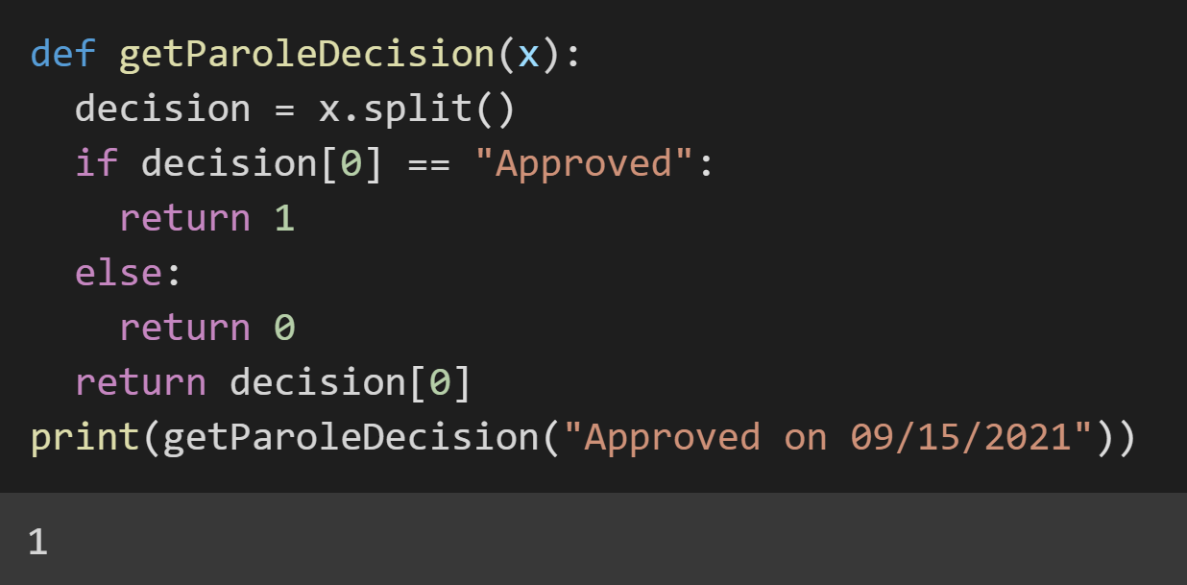
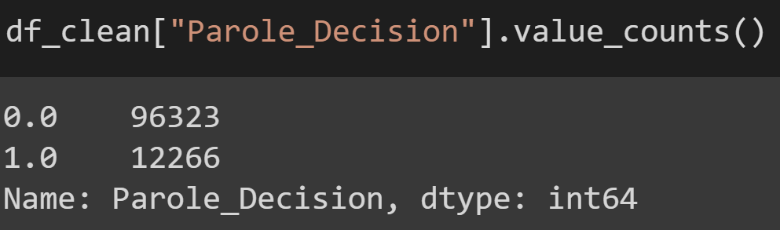
Encoding Last Parole Decision

Slide 16
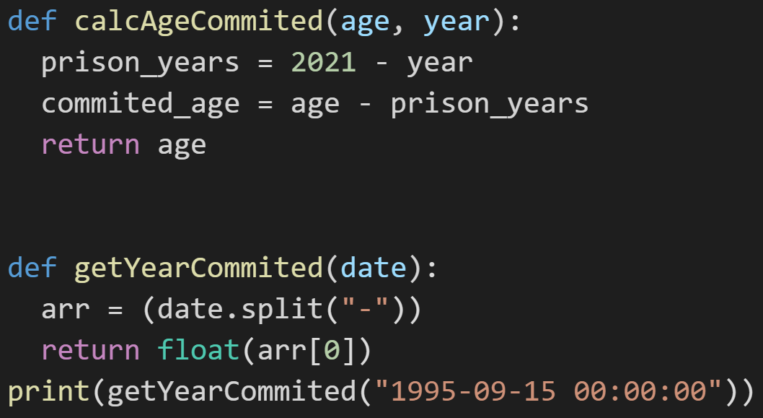
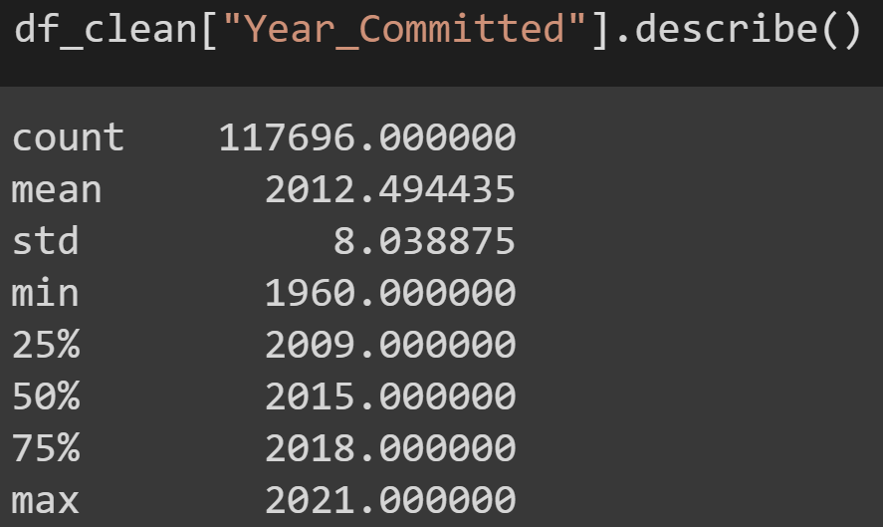
New Columns: “Age Committed” and “Year Committed”
Those who got Life: 8101 before 2012, 1649 after 2012

Slide 17
3. Models

Slide 18
Linear Regression
Because our dataset is mostly categorical data, our attempt to create a linear regression model that predicted exactly how many years an individual would be sentenced (based off of our “Offense Score” we created earlier) was very inaccurate and inconsistent…

Slide 19
CatBoost (Categorical Boost)
Because of large amount of unique Categorical data, we used CatBoost: a gradient descent boosting tree.
Our 16,000 unique Offenses made CatBoost the perfect model
Changed Virtual Judge to a Classification Problem

Slide 20
Predicting Life or no Life in Prison

Slide 21
Real World Application: Removing Target Leaking
We want the Virtual Judge to only have the information that it would have when it is trying to predict a new individual
'Current Age'
'Projected Release'
'Maximum Sentence Date'
'Parole Eligibility Date'
'Last Parole Decision'
'Next Parole Review Date'
'Current Facility'
'Parole_Decision'
'Parole Review Status'

Slide 22
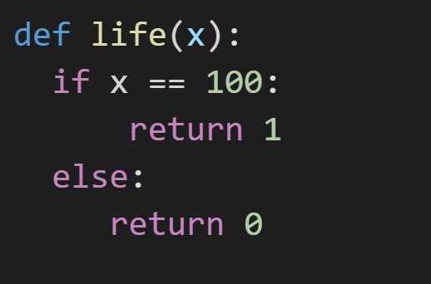
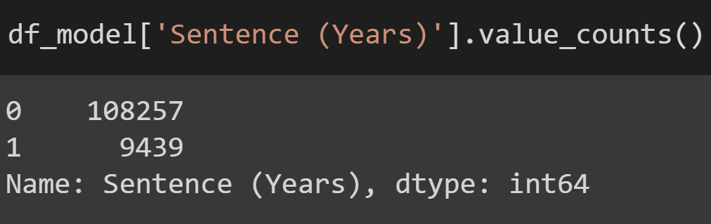
Not Life 0, Life 1
The number of people who are not serving life in prison FAR OUTWEIGHS the number of people who are serving life…

Slide 23
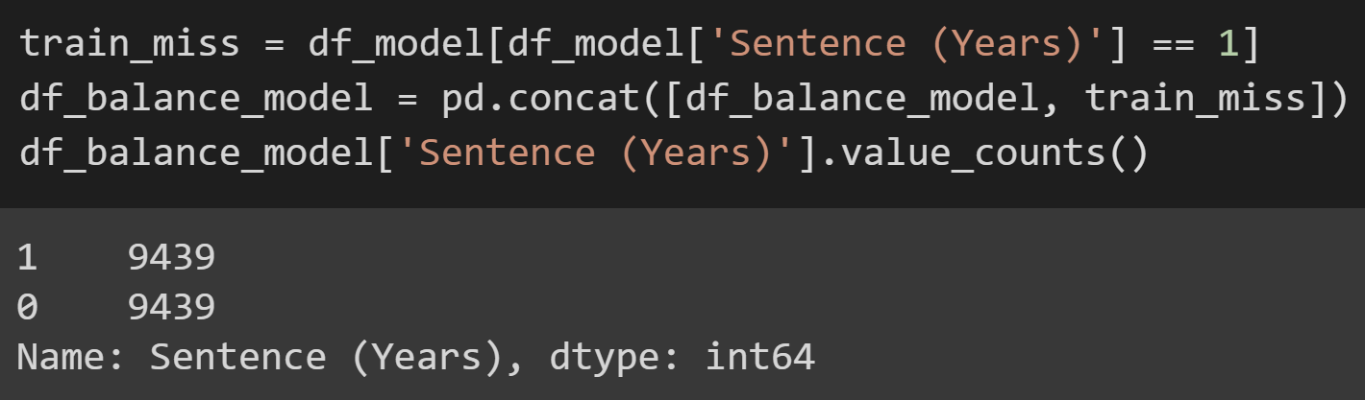
Balanced Model (Life or No Life)

Slide 24
Balanced Model: CatBoost Parameters (Life or No Life)
Iterations: The number of Tree’s it uses to makes its prediction
50
Depth: The number of splits a tree has / how deep it can go
3
Learning Rate: Used for reducing the gradient step
0.1
Loss Function: Logloss
Is the negative average of the log of corrected predicted probabilities for each instance
For any given problem, a lower log loss value means better predictions.

Slide 25
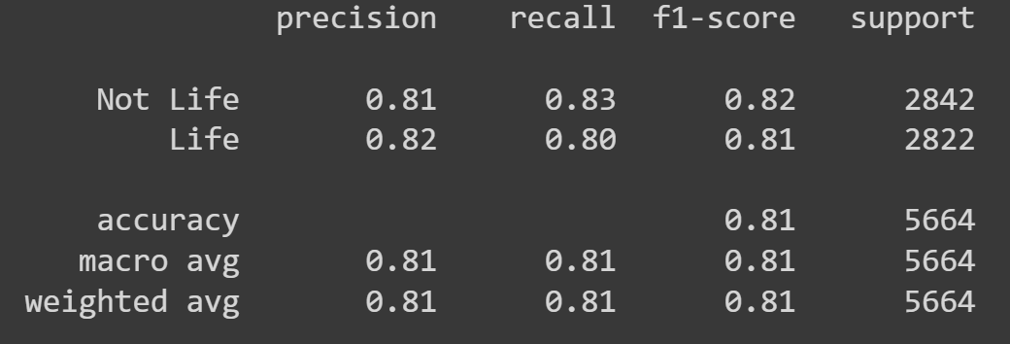
Balanced Life or No Life Results
Accuracy Score: 0.8132

Slide 26
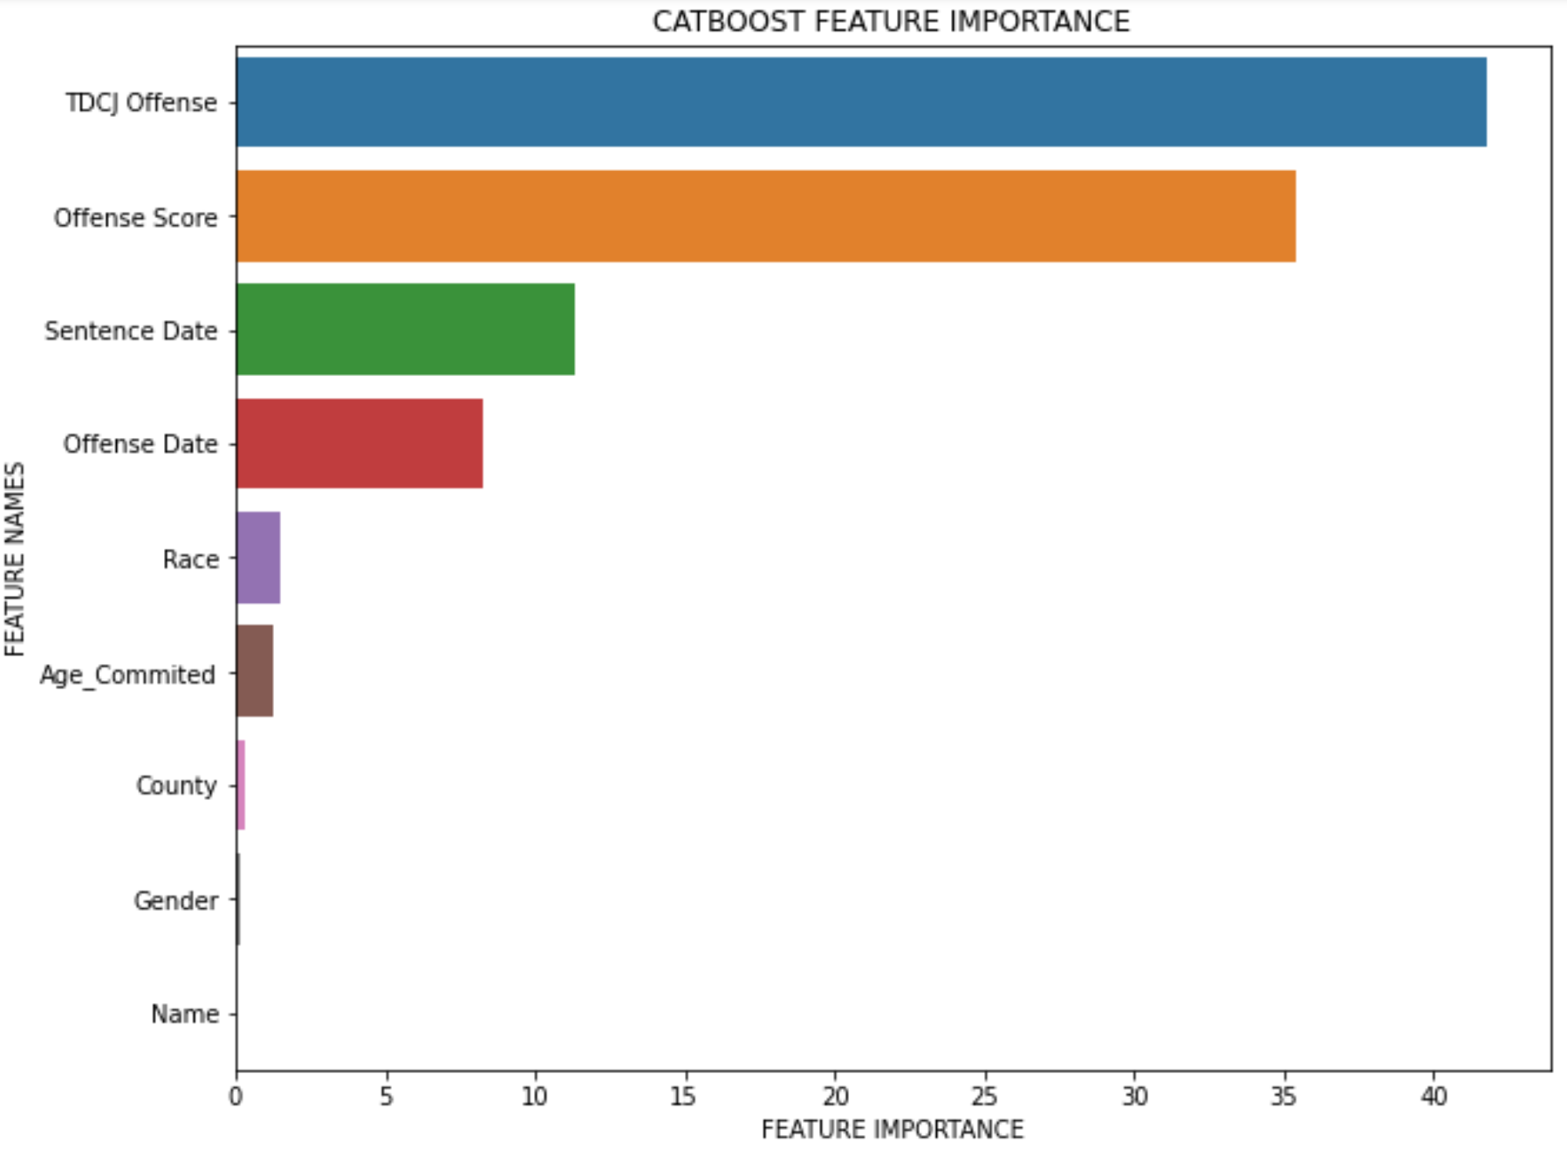

Slide 27
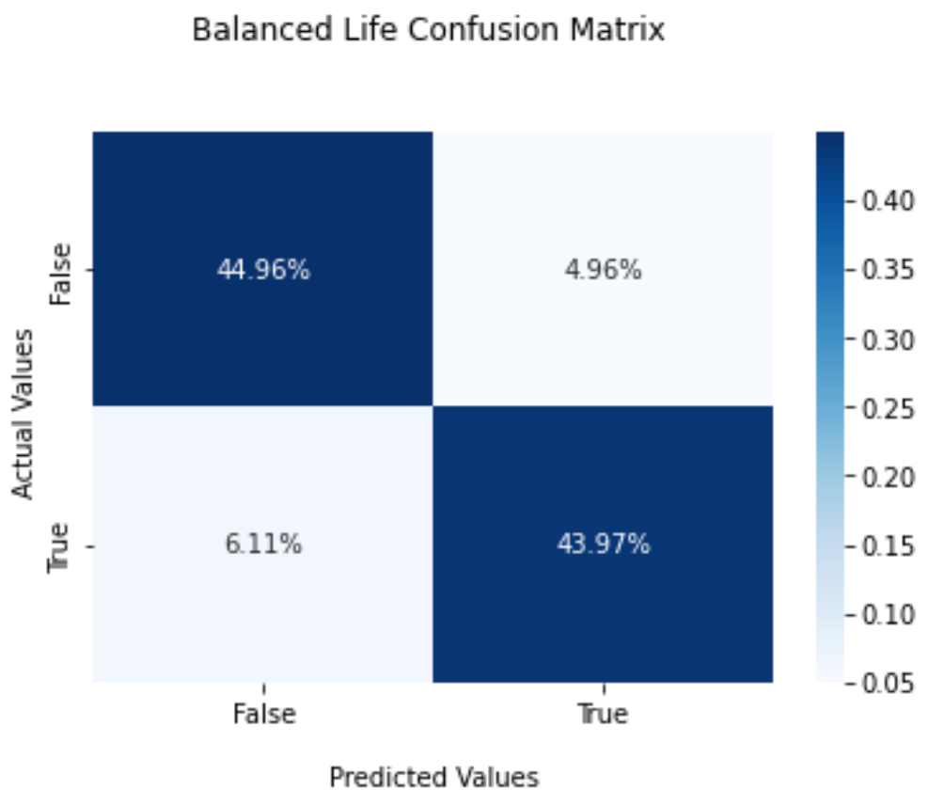

Slide 28
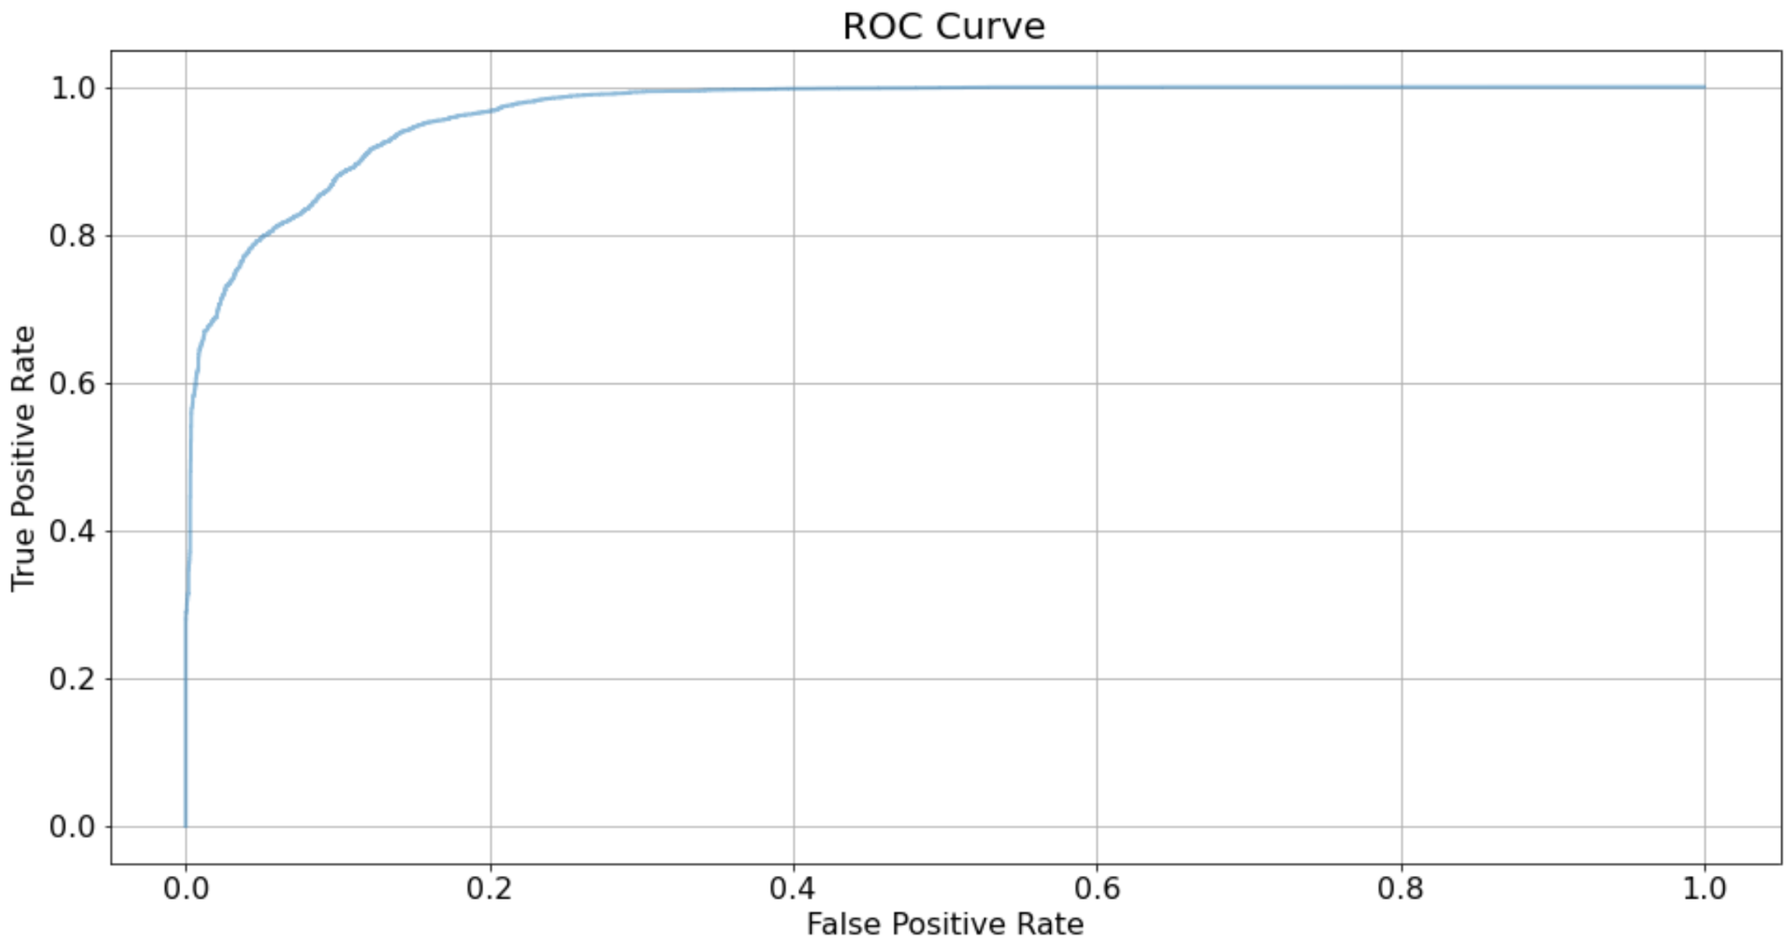

Slide 29
Without Balancing (Life or No Life)

Slide 30
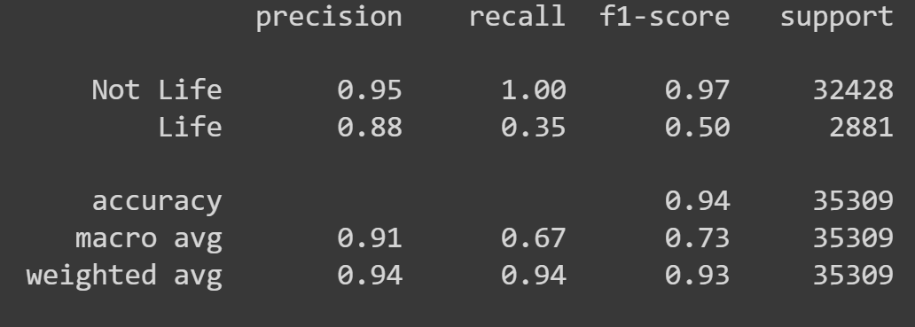
Not Balanced Life or No Life Results
Accuracy Score: 0.9428

Slide 31
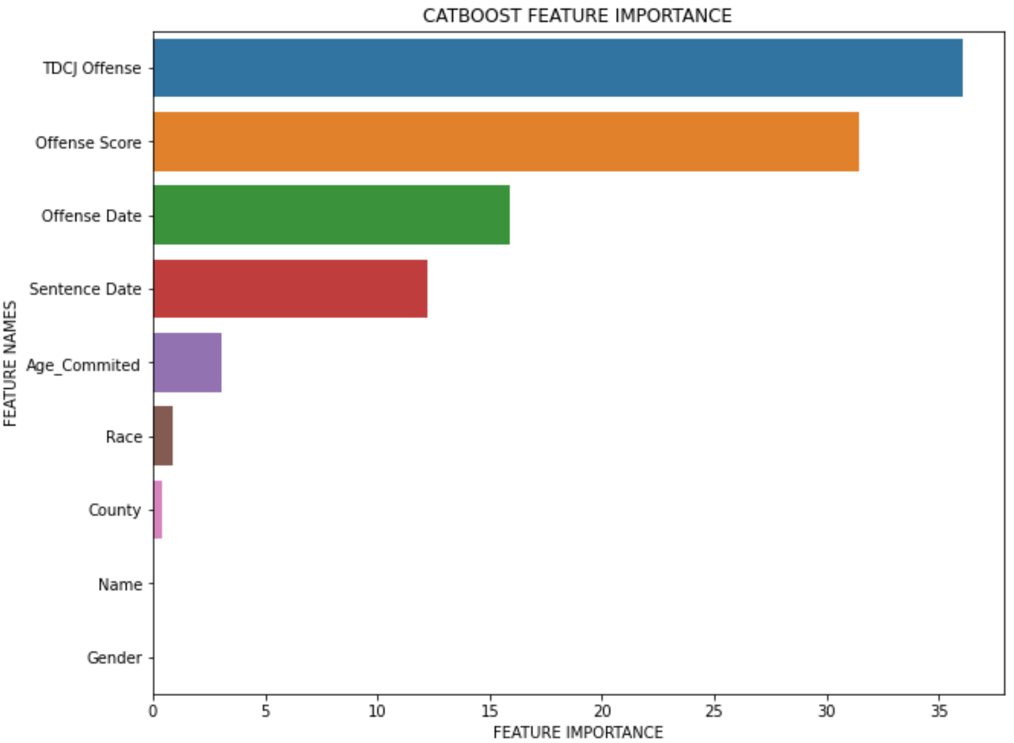

Slide 32
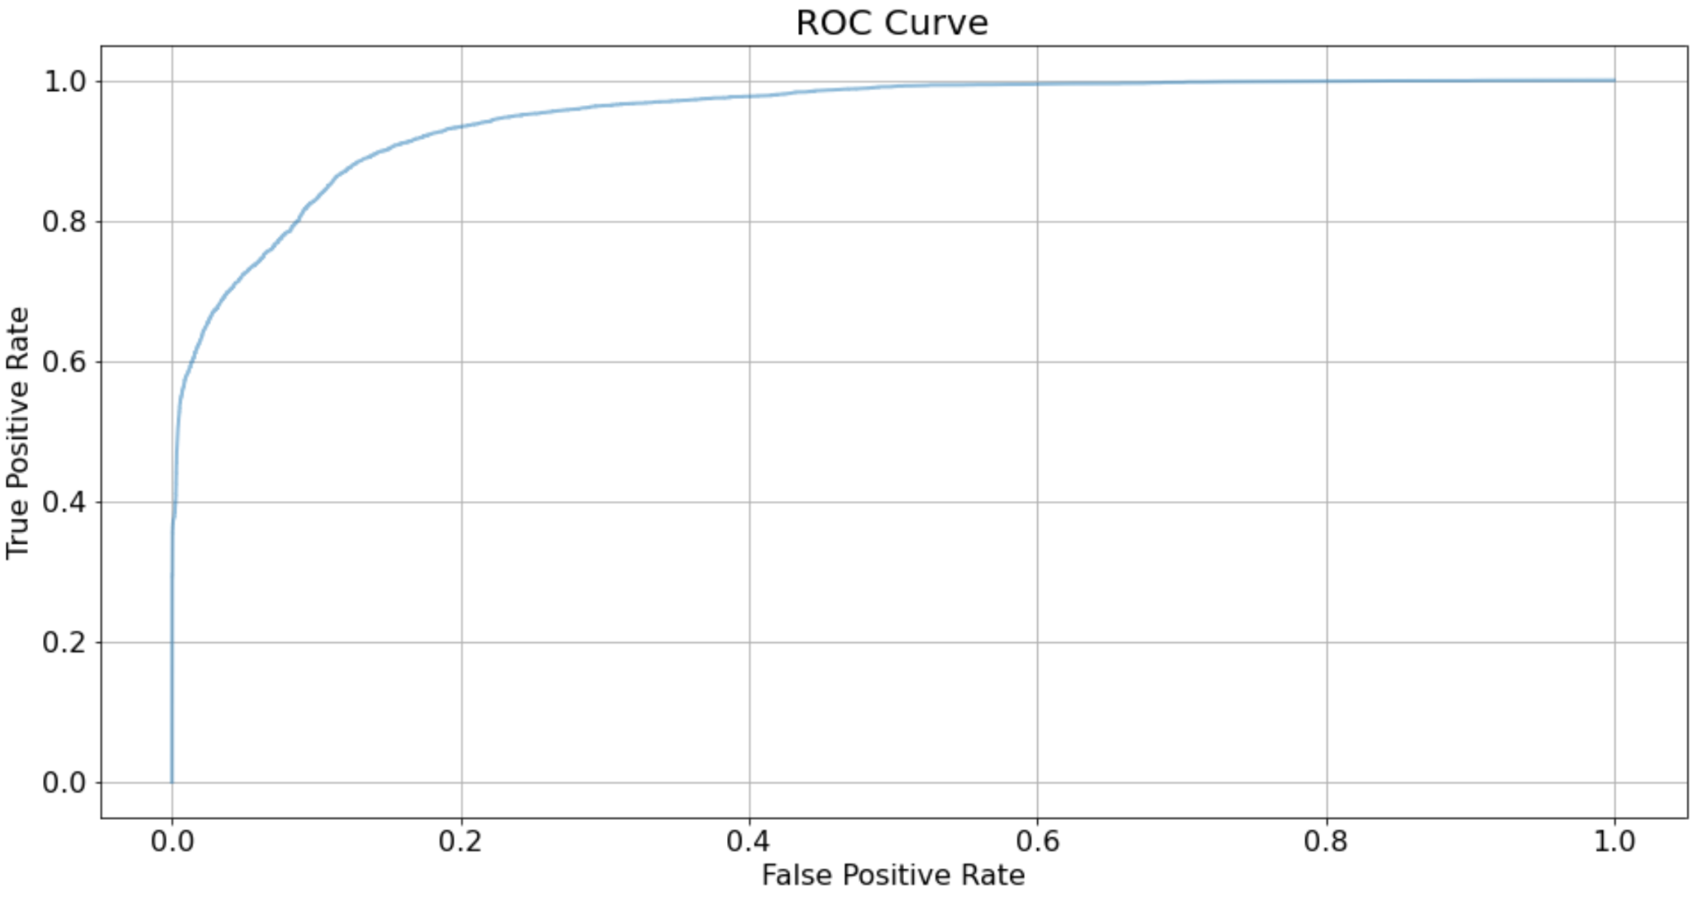

Slide 33
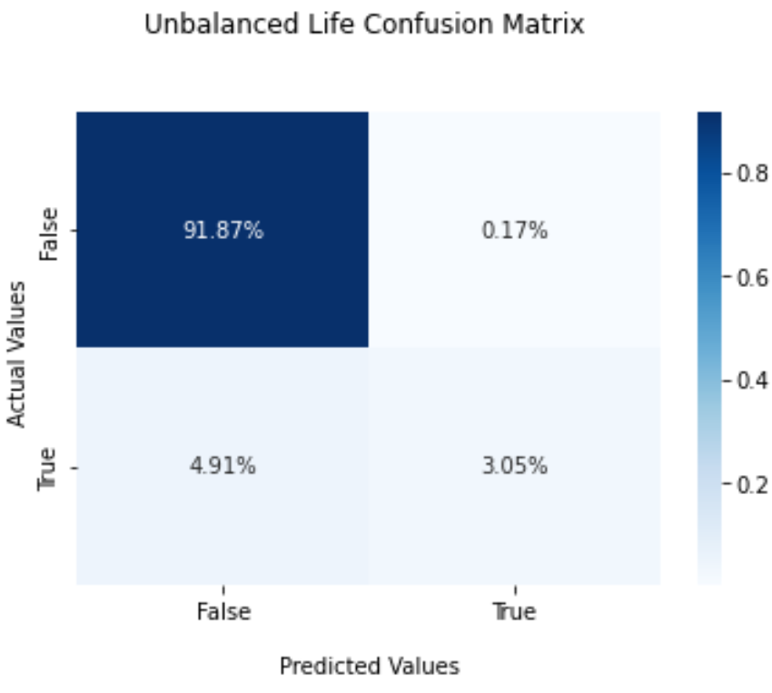

Slide 34
Predicting over a 50 year sentencing

Slide 35
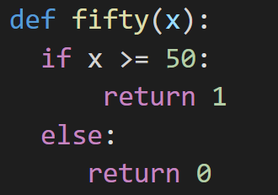
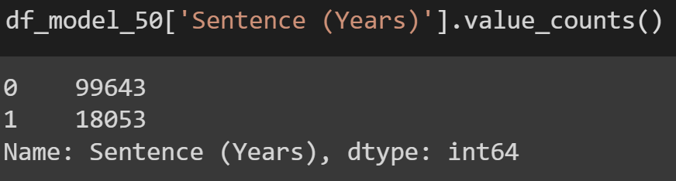
Under 50 years 0, Over 50 years 1

Slide 36
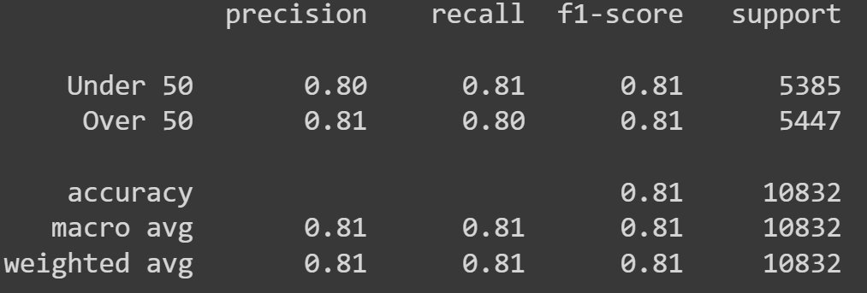
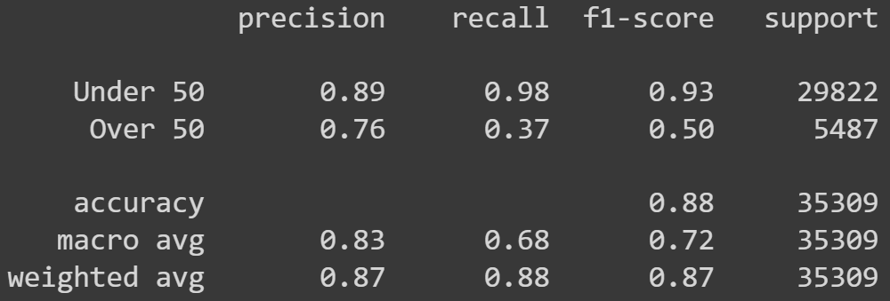
50 Year Prediction Results
Balanced
Unbalanced
Accuracy Score: 0.8140
Accuracy Score: 0.8846

Slide 37
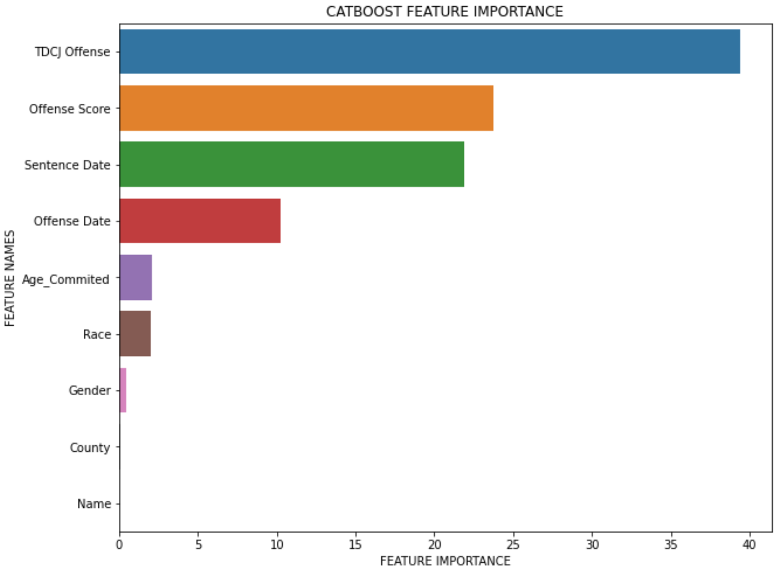
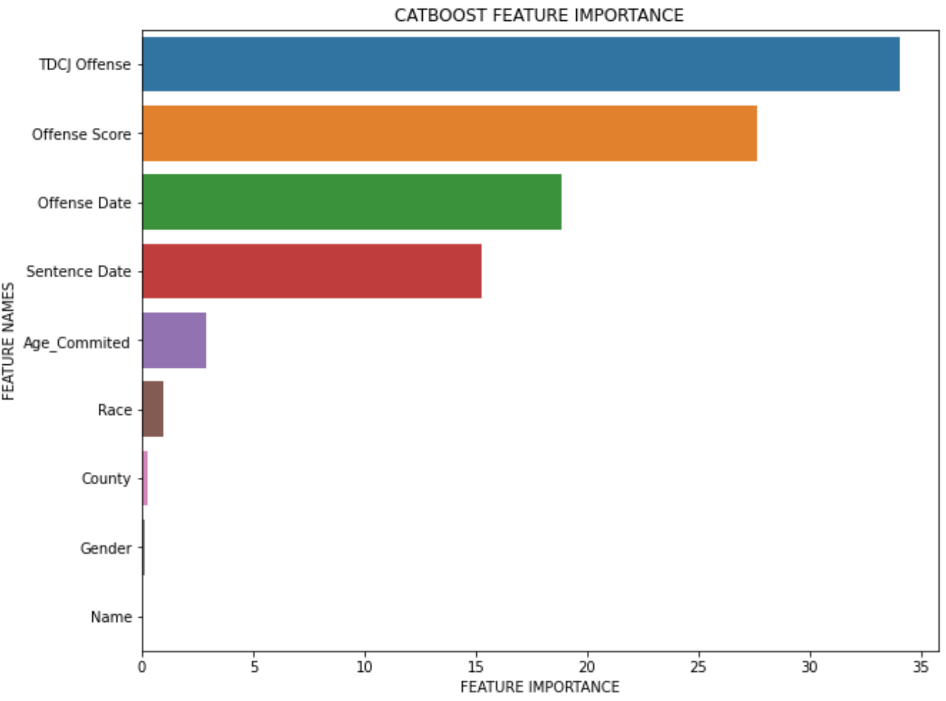
50 Year Prediction Results
Balanced
Unbalanced

Slide 38
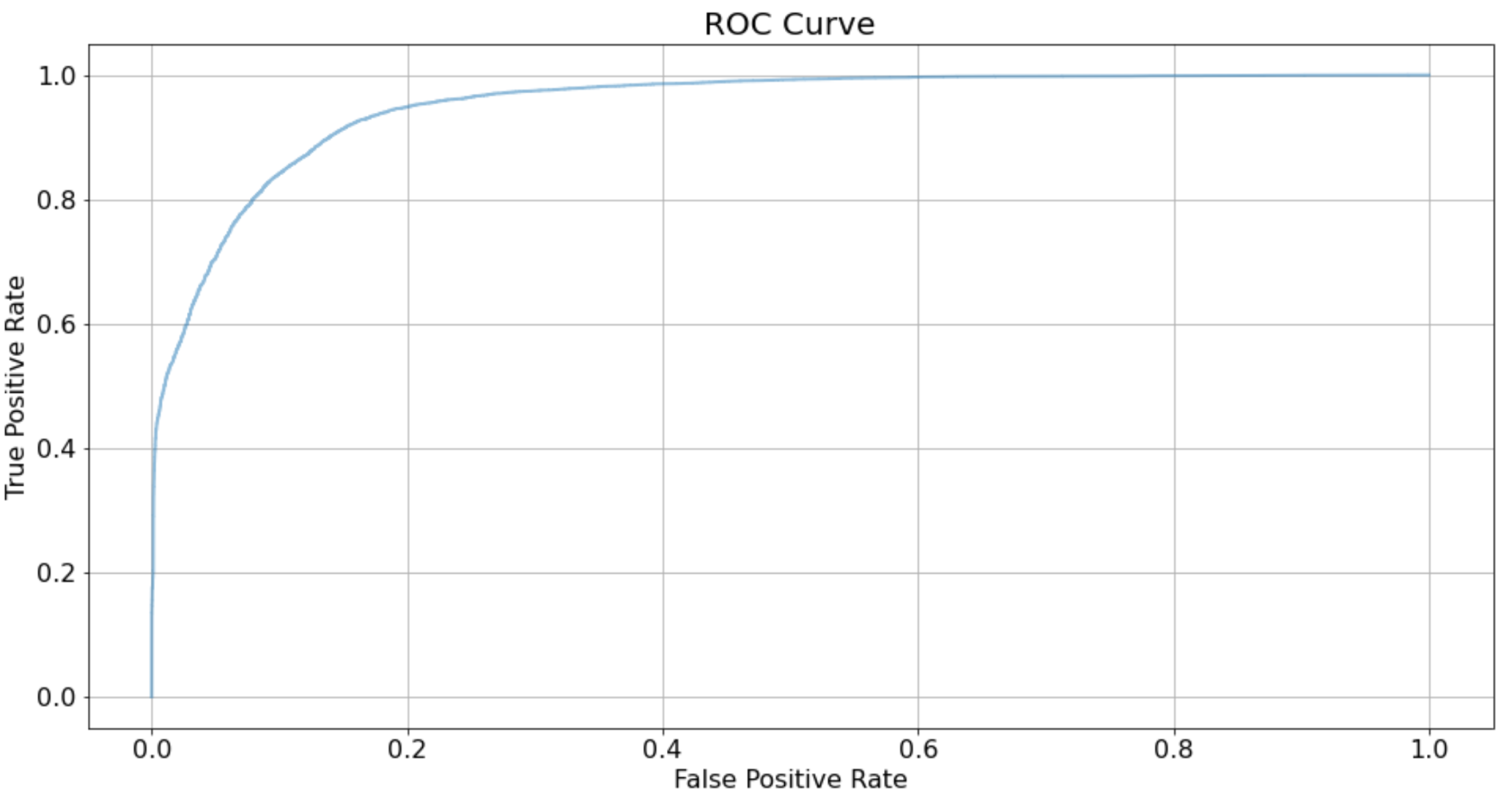
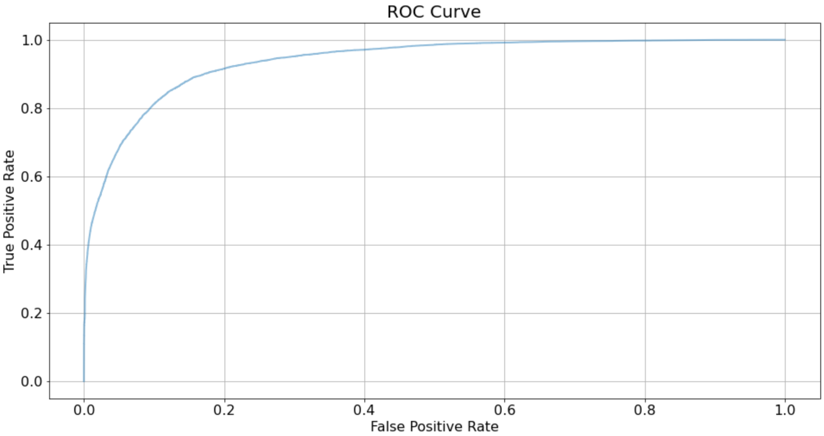
50 Year Prediction Results
Balanced
Unbalanced

Slide 39
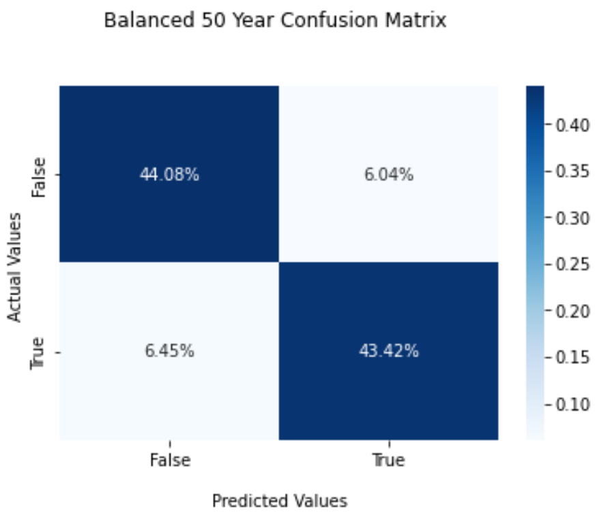
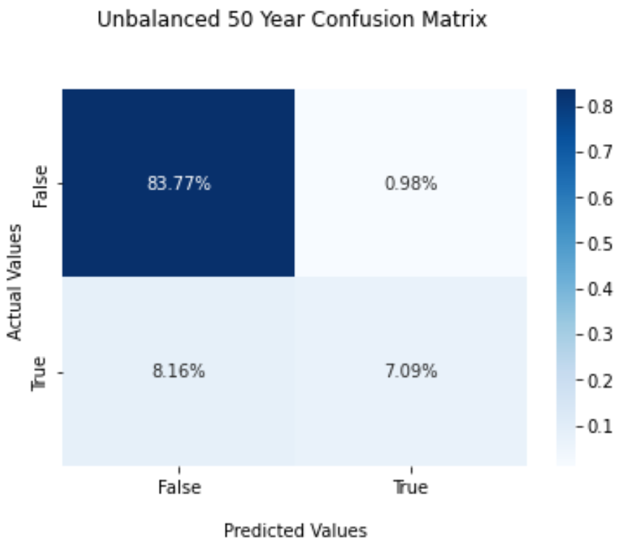
50 Year Prediction Results
Balanced
Unbalanced

Slide 40
Predicting over a 20 year sentencing

Slide 41
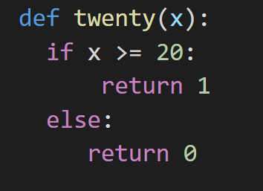
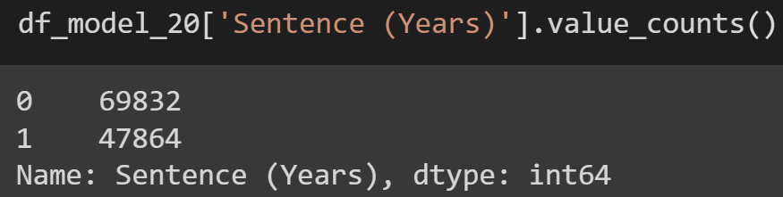
Under 20 years 0, Over 20 years 1

Slide 42

20 Year Prediction Results
Accuracy Score: 0.8399

Slide 43
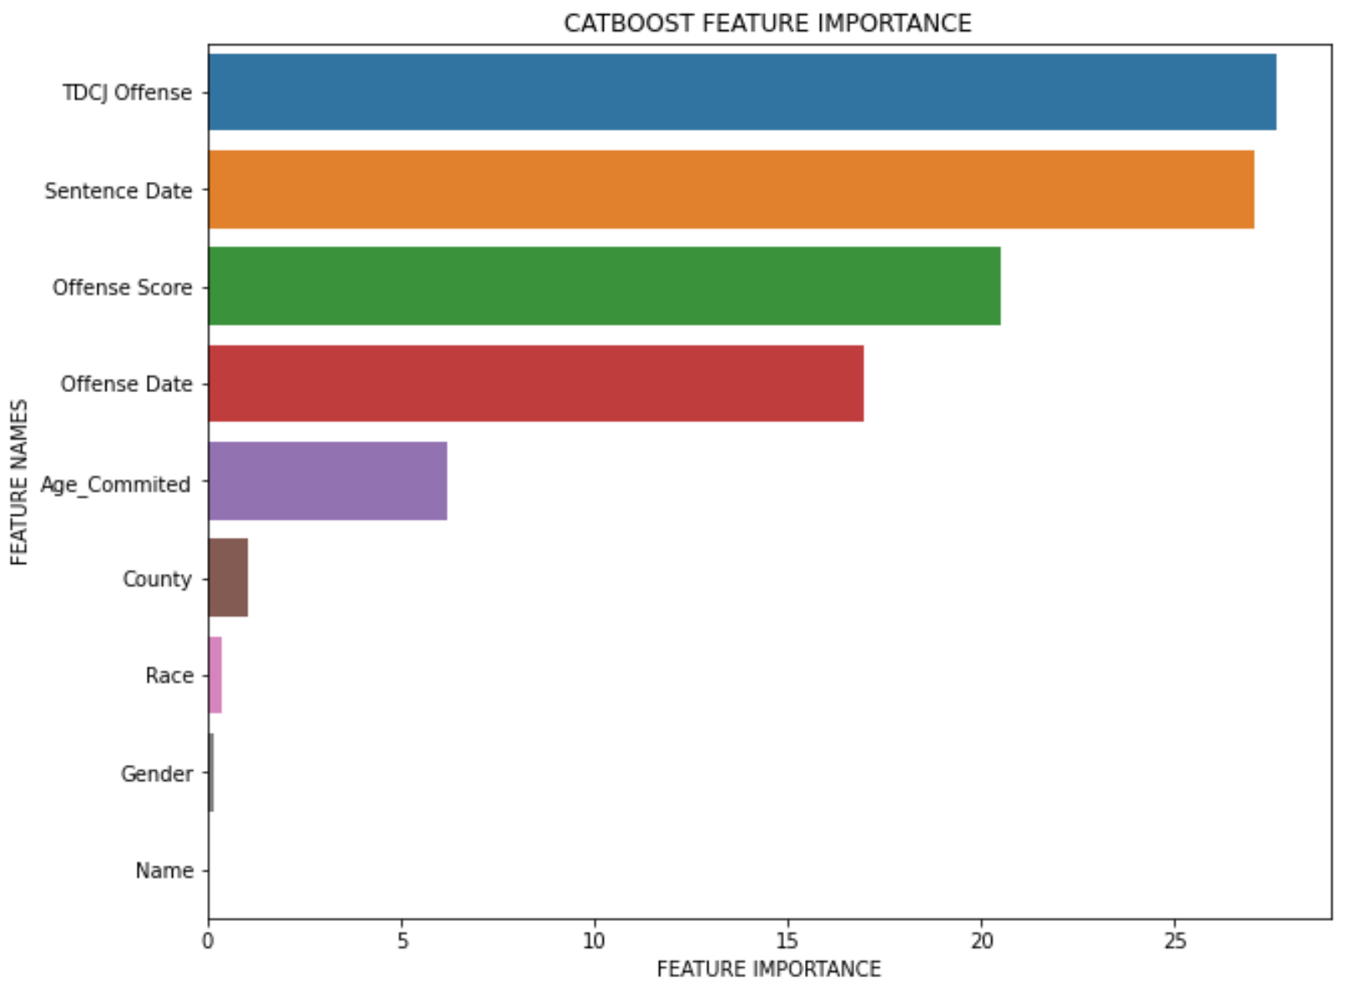
20 Year Prediction Results

Slide 44
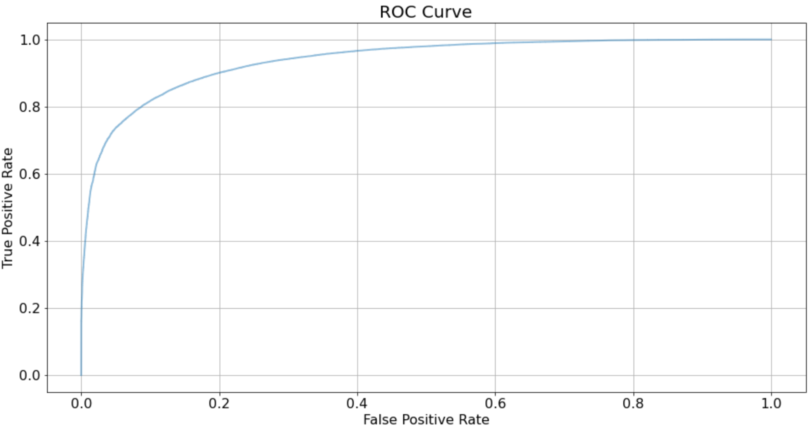
20 Year Prediction Results

Slide 45
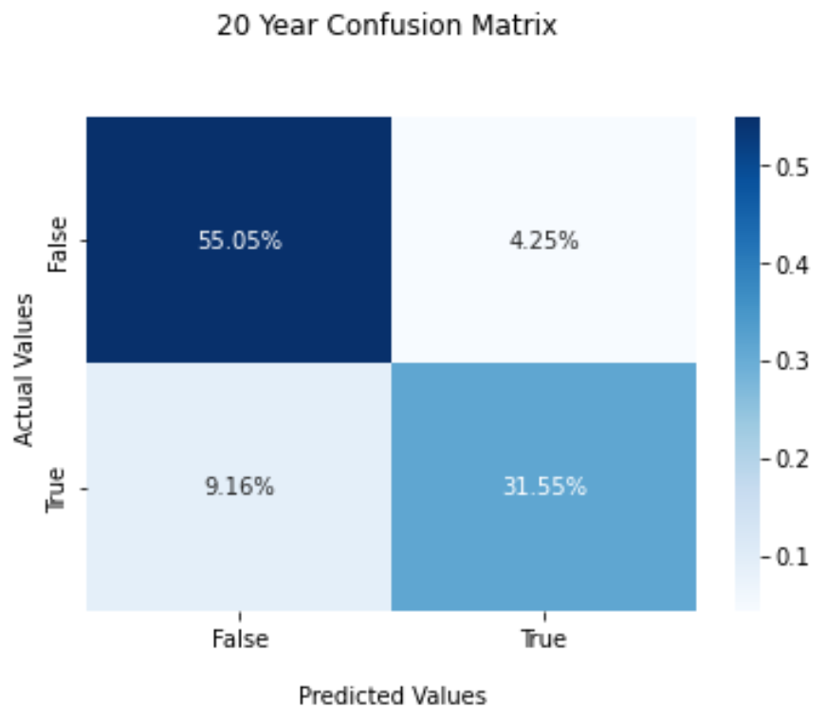
20 Year Prediction Results

Slide 46
Predicting if someone will get approved for parole

Slide 47
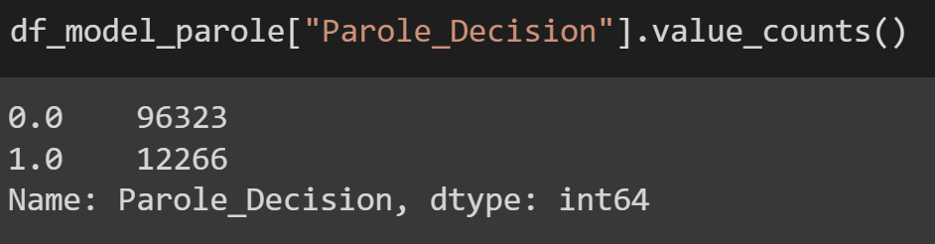
No Parole 0, Approved for Parole 1

Slide 48
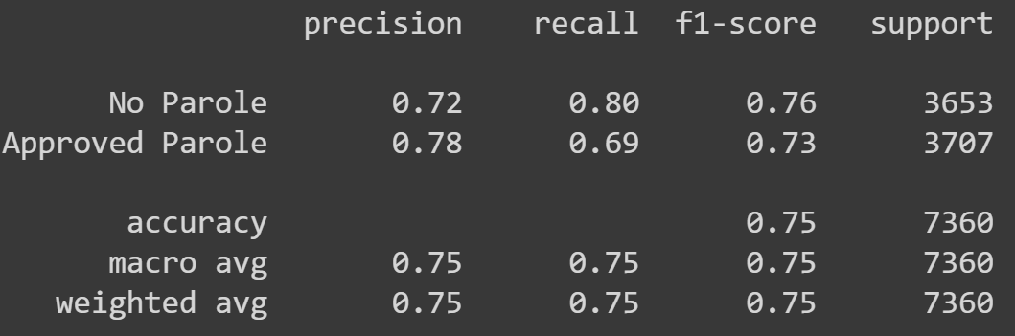
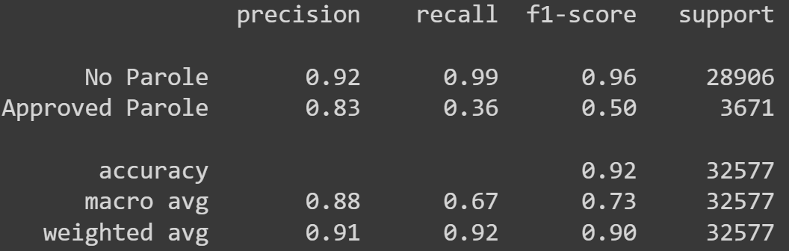
Parole Prediction Results
Balanced
Unbalanced
Accuracy Score: 0.7520
Accuracy Score: 0.9195

Slide 49
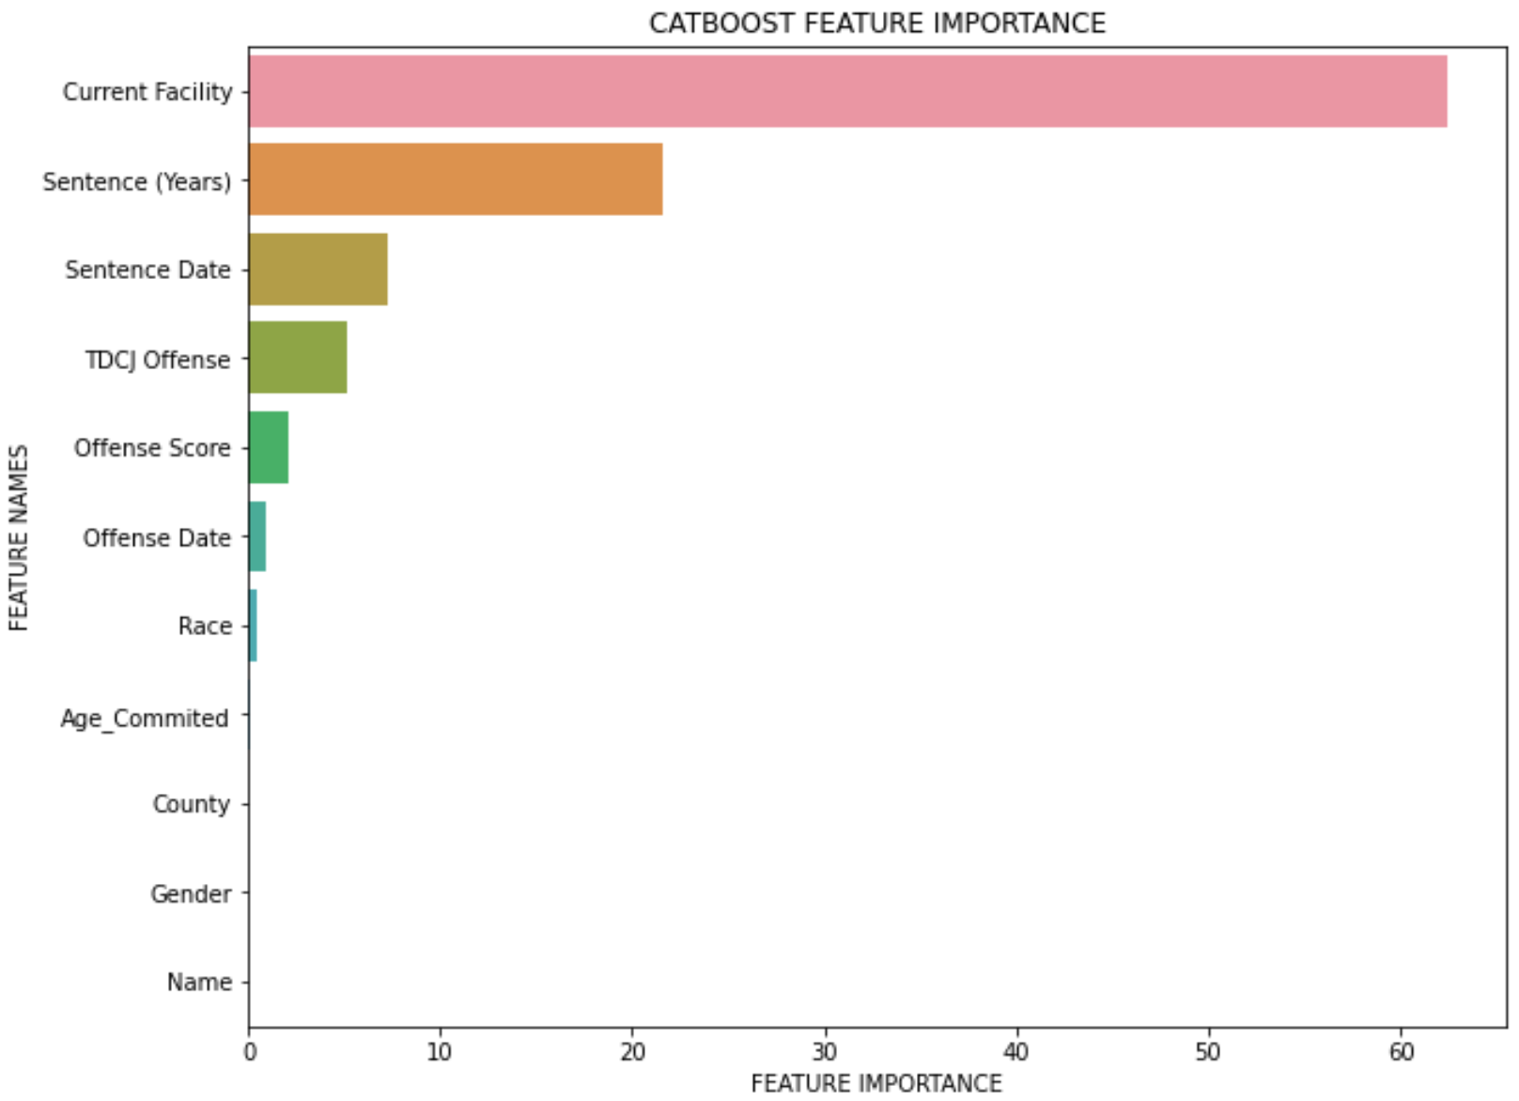
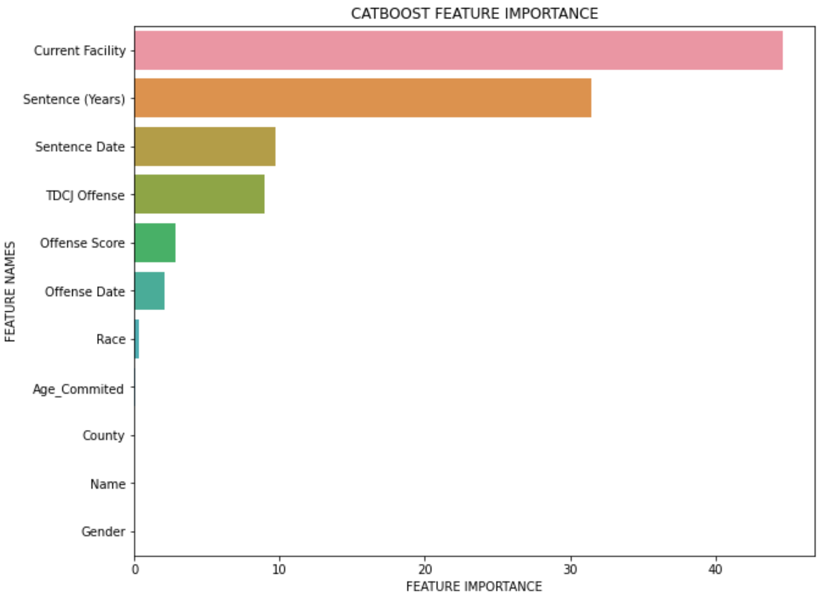
Parole Prediction Results
Balanced
Unbalanced

Slide 50
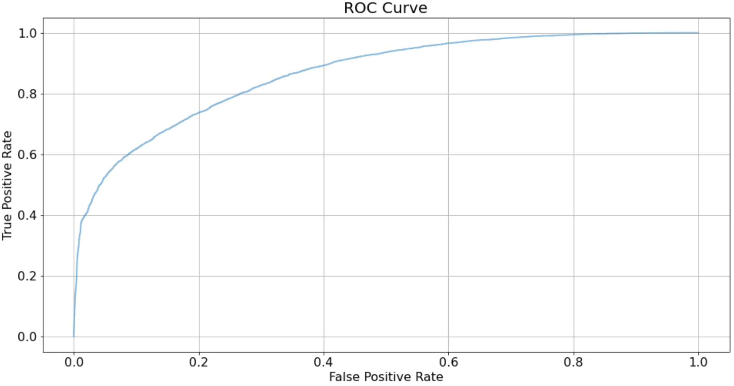
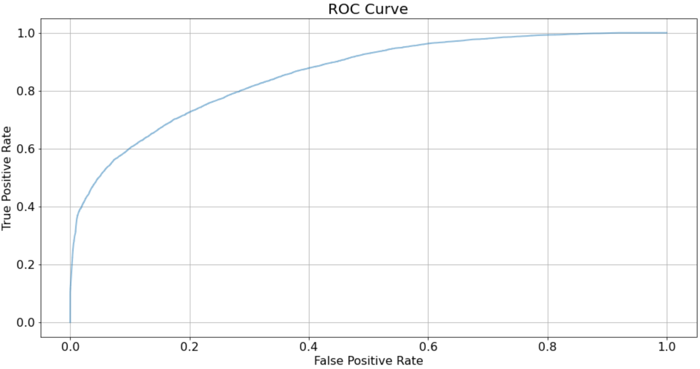
Parole Prediction Results
Balanced
Unbalanced

Slide 51
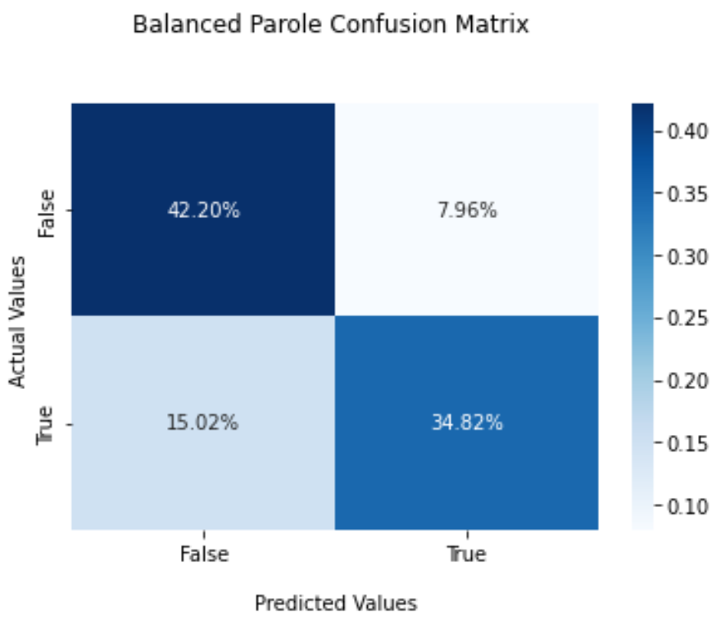

Parole Prediction Results
Balanced
Unbalanced

Slide 52
The Virtual Judge Conclusion

Slide 53
The Virtual Judge can be used to uncover human biases in the criminal justice system
False Negatives - we predict they should not get life, but they actually do get life
Maybe the Virtual Judge is missing key details pertaining to the particular crime?
Or maybe the sentencing was unfair, with too much weight on factors such as Race or Age
Maybe an evaluation of similar cases is needed
Maybe an evaluation of the judge is needed
The Virtual Judge can be used to appeal unjust sentencings
The Virtual Judge cannot replace a real Judge/Jury

Slide 54
Thanks!
Any questions?
You can find us at
www.linkedin.com/in/kyle-moses-development
linkedin.com/in/irvin-quartey-73533261/
https://www.linkedin.com/in/marisol/

